Slide 1
Project title
CAPSTONE PROJECT
Presented By:
Student Name- Rishitha yamasani
College Name- Malla Reddy college of engineering for women
Department- CSE(AI&ML)

Slide 2
OUTLINE
Problem Statement
Proposed System/Solution
System Development Approach
Algorithm & Deployment
Result
Conclusion
Future Scope
References

Slide 3
Problem Statement
.
Students often struggle to understand complex academic concepts during self-study. Searching for information online frequently results in long, irrelevant, or unstructured content, which makes learning time-consuming and confusing. Additionally, teachers may not always be available to provide immediate assistance when students face doubts.
There is also a lack of personalized and interactive learning tools that can explain concepts in simple language, summarize study notes, and help students assess their understanding through quizzes and flashcards.
Therefore, there is a need for an AI-powered Study Buddy that provides instant, simple, and interactive learning support to help students learn effectively at their own pace.

Slide 4
Proposed Solution
It is designed to assist students in understanding academic concepts effectively. The system aims to support self-paced learning by providing instant and accurate responses to student queries. It reduces dependency on long and irrelevant online searches and helps students when teachers are not immediately available. The application explains topics in simple and clear language, making learning easier for beginners. It also supports interactive learning by allowing students to ask questions through a user-friendly interface. Natural Language Processing techniques are used to analyze user input and match it with relevant information stored in the dataset. Overall, the proposed solution enhances the learning experience by making education more accessible, interactive, and efficient.

Slide 5
System Approach
The system uses Natural Language Processing techniques to understand and respond to user queries.
Python – Used for developing the backend logic, data processing, and NLP operations due to its simplicity and rich library support.
Streamlit – Used to create an interactive and user-friendly web interface for the AI Study Buddy.
Pandas – Used for loading, managing, and processing the CSV dataset efficiently.
Scikit-learn – Used for implementing TF-IDF vectorization and cosine similarity to match user questions with relevant answers.
VS Code – Used as the code editor for development and debugging.
Natural Language Processing (NLP) – Used to analyze and understand user input text

Slide 6
Algorithm & Deployment
.
Alogirthm:
1.Start the application.
2.Load the question–answer dataset from the CSV file.
3.Preprocess and vectorize questions using TF-IDF.
4.Accept user input through the Streamlit interface.Convert the input query into vector form.
5.Compute cosine similarity between input and dataset questions.
6.Identify the highest similarity score.
7.Retrieve and display the corresponding answer.
8.Generate quizzes, summaries, or flashcards if selected.
9.End the process.
Deployment
• The complete project is uploaded to GitHub repository. • A requirements.txt file is used to manage dependencies. • Streamlit Cloud installs required libraries automatically. • The application runs on a cloud-based server. • Users can access the application through a web browser. • No local installation is required for end users.

Slide 7
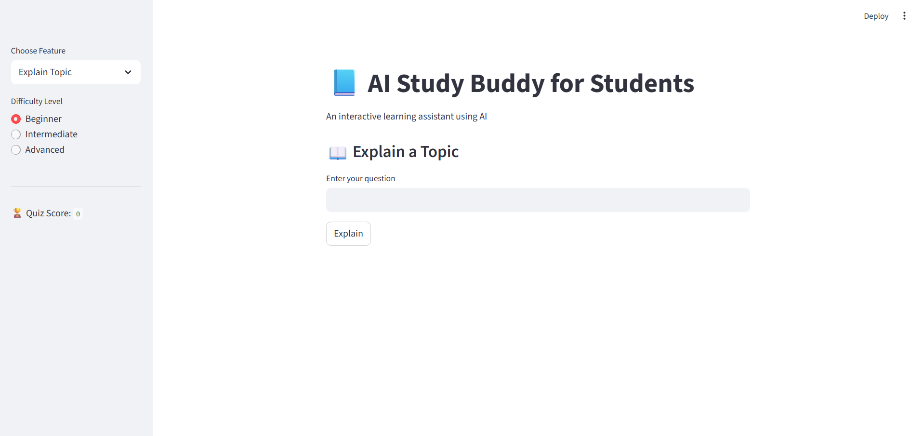
Result
The AI Study Buddy was successfully implemented and tested. The system provides accurate answers, summaries, quizzes, and flashcards through an interactive Streamlit interface.

Slide 8
Conclusion
The AI Study Buddy for Students was successfully designed and implemented to support effective and self-paced learning. The system addresses common learning challenges by providing simple explanations, summarizing study notes, and offering interactive features such as quizzes and flashcards.
By using Natural Language Processing techniques like TF-IDF and cosine similarity, the application delivers relevant and accurate responses based on the given dataset. The Streamlit interface makes the system easy to use and engaging for students.
Overall, the AI Study Buddy enhances the learning experience by saving time, improving understanding, and encouraging active student participation. The project demonstrates how AI and NLP can be effectively applied in the field of education.

Slide 9
Future scope
The AI Study Buddy can be further enhanced to provide a more advanced and personalized learning experience.
• Integration of advanced AI models such as Transformers for more accurate and detailed responses • Support for multiple subjects and larger datasets • Voice-based interaction using speech recognition • Personalized learning recommendations based on user performance • Mobile application development for wider accessibility • Cloud deployment for remote access and scalability
These enhancements will make the system more intelligent, flexible, and user-centric, improving its effectiveness in modern education.
.

Slide 10
References
Python Software Foundation, Python Documentation, Streamlit Inc., Streamlit Documentation, Scikit-learn Developers, Scikit-learn: Machine Learning in Python, Salton, G., Wong, A., & Yang, C. S., A Vector Space Model for Automatic Indexing
Natural Language Processing Concepts – TF-IDF and Cosine Similarity, Kaggle and Educational Open Datasets (for learning and experimentation)

Slide 11
Github link
https://github.com/Rishithayamasani/study-buddy-.git
https://rishithayamasani.github.io/study-buddy-/

Slide 12
THANK YOU

